Slide 1
Image Processing with CNNs
Prof. Sushree S. Behera
IIIT Bangalore
Notes:
Modules covered so far - Lexical and Syntactic Processing Semantic Processing and Classical Text Generation Introduction to Neurons and Neural Networks

Slide 2
Agenda
Introduction & Motivation
Understanding Image Data
CNN Architecture
Convolutional Layer
Feature Maps & Pooling Layers
Fully-connected Layers
Hierarchical Feature Learning
Transfer Learning and Fine-tuning
Back-propagation in CNNs
Various CNN Architectures and their Application

Slide 3
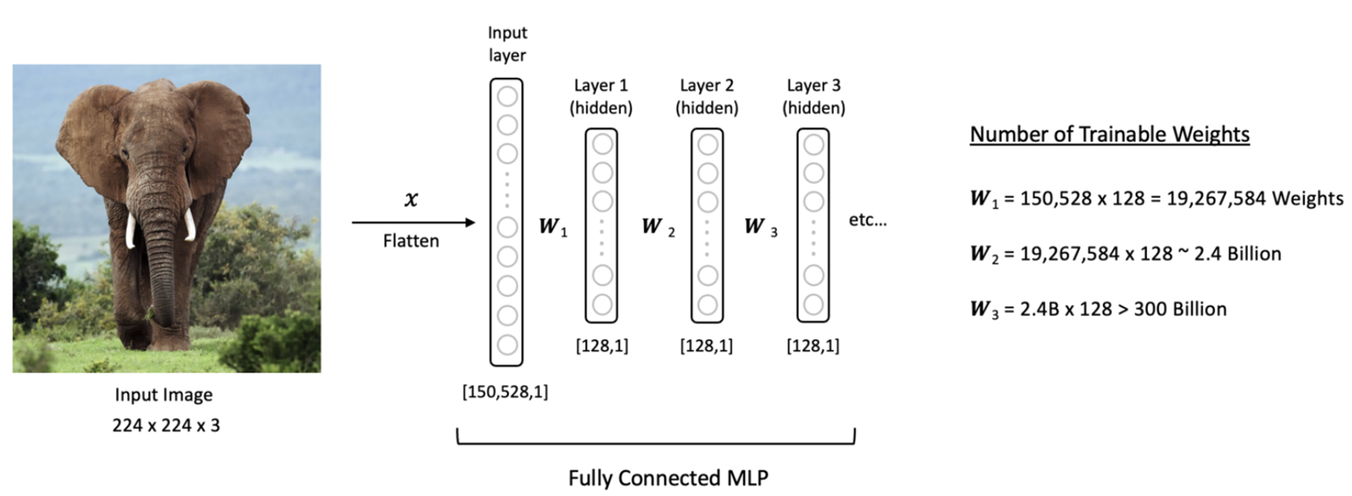
Convolutional Neural Networks
Hierarchical Feature Learning
https://learnopencv.com/understanding-convolutional-neural-networks-cnn/
https://www.geeksforgeeks.org/introduction-convolution-neural-network/

Slide 4
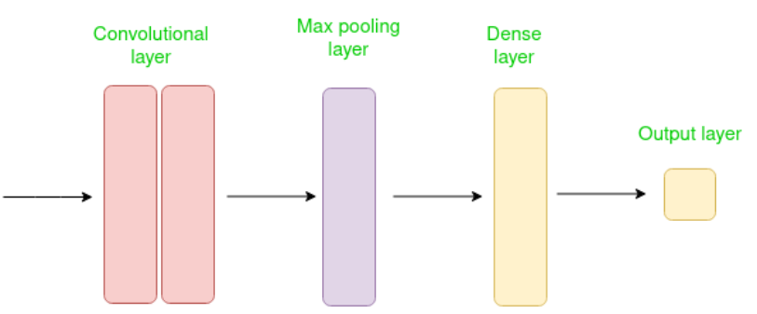
Convolutional Neural Networks
Designed to work with grid-structured inputs, with strong spatial dependencies in local regions.
https://learnopencv.com/understanding-convolutional-neural-networks-cnn/
https://www.geeksforgeeks.org/introduction-convolution-neural-network/

Slide 5

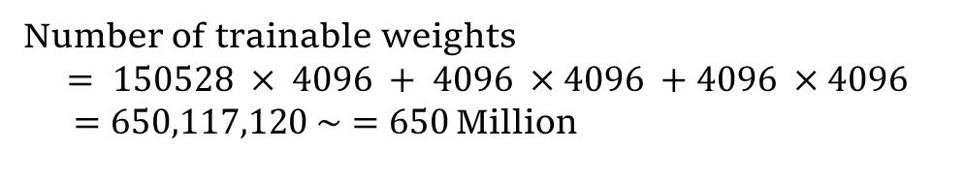
Convolutional Neural Networks
Number of trainable weights
$$= 150528 × 4096 + 4096 ×4096 +4096 ×4096$$
$=650,117,120 \sim =650$Million
https://learnopencv.com/understanding-convolutional-neural-networks-cnn/
Notes:
The basic difference between a CNN and the multi-layer FFNs is that inputs to CNNs are 2-D arrays (images), while inputs to our fully connected neural networks are vectors.

Slide 6
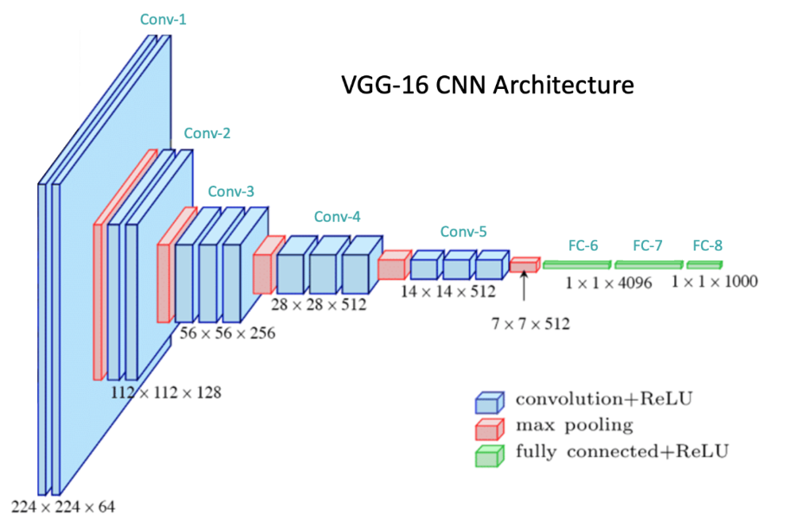
Convolutional Neural Networks
Total: 138M parameters
https://learnopencv.com/understanding-convolutional-neural-networks-cnn/
https://cs231n.github.io/convolutional-networks/#conv

Slide 7

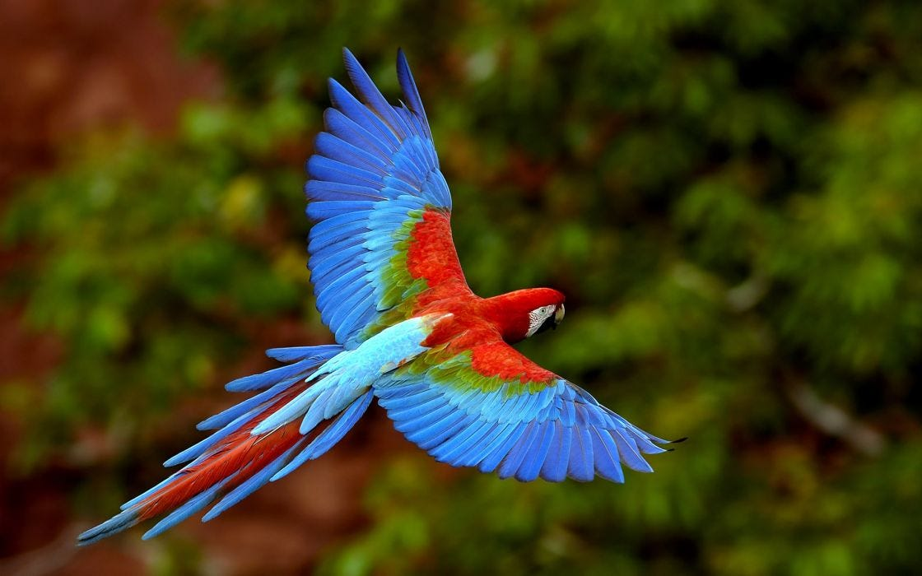

Digital Image
183 | 183 | 181 | 184 | 200 | 200
182 | 188 | 180 | 200 | 200 | 200
147 | 145 | 100 | 102 | 211 | 233
155 | 152 | 80 | 107 | 200 | 100
162 | 159 | 100 | 100 | 100 | 155
56 | 82 | 47 | 52 | 100 | 102
R
183 | 183 | 181 | 184 | 200 | 200
182 | 188 | 180 | 200 | 200 | 200
147 | 145 | 100 | 102 | 211 | 233
155 | 152 | 80 | 107 | 200 | 100
162 | 159 | 100 | 100 | 100 | 155
56 | 82 | 47 | 52 | 100 | 102
G
178 | 179 | 181 | 184 | 189 | 188
178 | 158 | 180 | 188 | 192 | 200
145 | 145 | 100 | 102 | 211 | 233
158 | 152 | 80 | 107 | 200 | 100
159 | 159 | 100 | 100 | 100 | 155
59 | 58 | 47 | 52 | 100 | 102
B
https://www.google.com/
Notes:
A digital camera perceives and stores an image as matrices, consisting of numbers. Typical color images are called RGB images, consisting of Red, Green, and Blue channels.

Slide 8
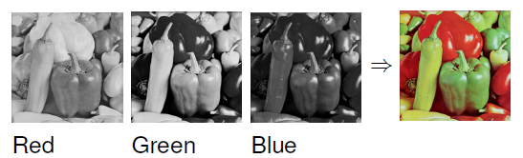
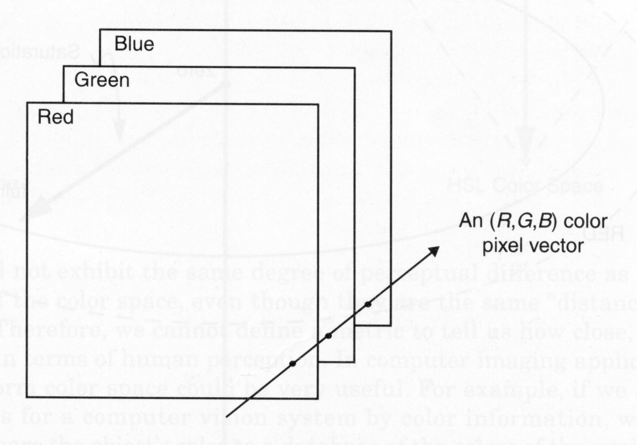
Digital Image
Gonzalez, Rafael C. Digital image processing. Pearson Education India.
Notes:
An image is represented as a tensor with dimension $M×N×3$, formed by concatenating three $M×N$ matrices. The dimensions are called height, width, and channel. So, one RGB image can be considered as a concatenation of three $2D$ images.

Slide 9
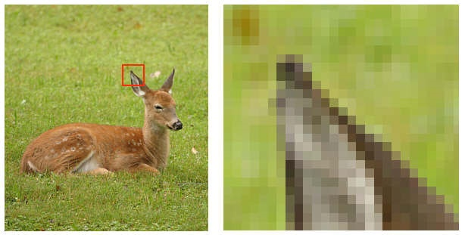
Digital Image
Represented as a finite set of digital values, called picture elements or pixels.
1 pixel
Red
10 | 13 | 50 | 84 | 102
17 | 145 | 100 | 102 | 233
15 | 152 | 80 | 107 | 100
16 | 159 | 100 | 100 | 155
5 | 82 | 47 | 52 | 102
Green
50 | 86 | 155 | 185 | 200
64 | 145 | 100 | 102 | 233
85 | 152 | 80 | 107 | 100
71 | 159 | 100 | 100 | 155
55 | 82 | 47 | 52 | 102
183 | 183 | 181 | 184 | 200
147 | 145 | 100 | 102 | 233
155 | 152 | 80 | 107 | 100
162 | 159 | 100 | 100 | 155
56 | 82 | 47 | 52 | 102
Blue
Notes:
The value of a pixel is assigned according to the intensity of light falling on each location in an image. Pixel values at a location is called the gray levels or intensity of the image at that location.

Slide 10
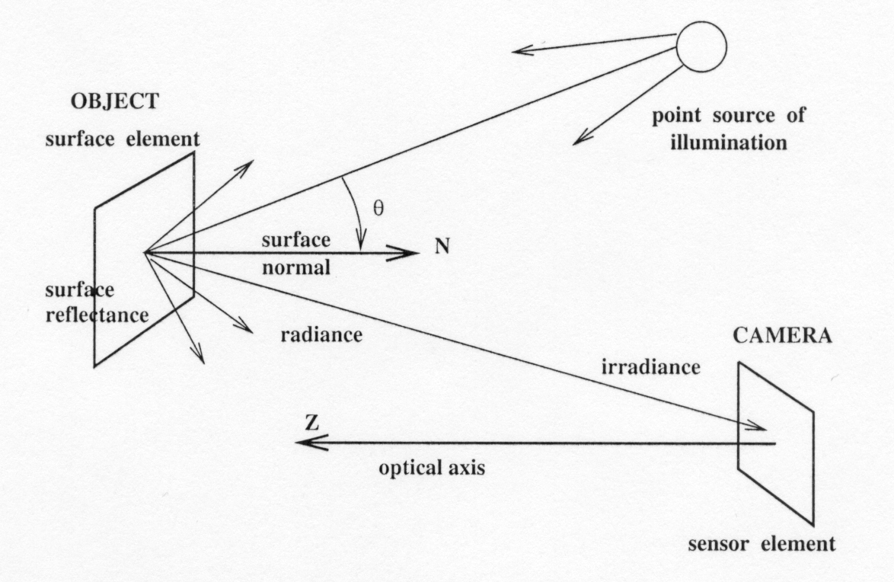
Image Formation
$$f\left(x,y\right)=i\left(x,y\right).r(x,y)$$
$f(x,y)$– Image formed $(0−∞)$
$i(x,y)$– Illumination component $(0−∞)$
$r(x,y)$– Reflectance component $(0−1)$
https://www.youtube.com/watch?v=_EhY31MSbNM&t=820s
https://www.youtube.com/watch?v=7LX-19v_9ns
Gonzalez, Rafael C. Digital image processing. Pearson Education India.
Notes:
The illumination component is determined by the illumination or light source and the reflectance component is determined by the characteristics of the imaged object.

Slide 11
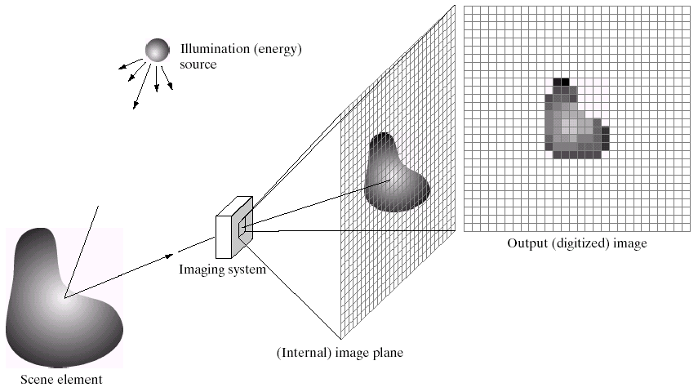
Image Digitization
Approximation of a real scene into an image.
Gonzalez, Rafael C. Digital image processing. Pearson Education India.

Slide 12
Image Digitization
Sampling: measuring the value of an image at a finite number of points.
Quantization: representing the measured value at the sampled point by an integer.
Gonzalez, Rafael C. Digital image processing. Pearson Education India.

Slide 13
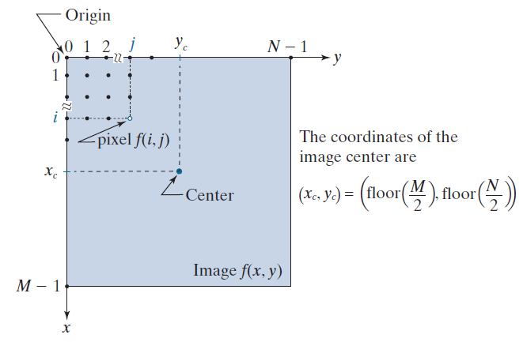
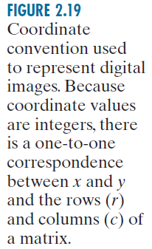
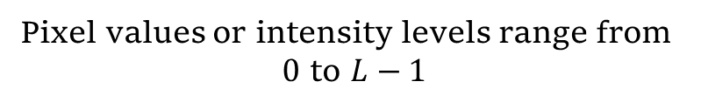
Digital Image: Representation
Pixel values or intensity levels range from
$0$ to $L−1$
Gonzalez, Rafael C. Digital image processing. Pearson Education India.
Notes:
In the case of $k$ bits/pixels, there are $2^{k}$ gray levels. For a $k−$bit system, the pixel values or intensity levels range from $0$ to $L−1$, where $L = 2^{k}$, $k$ is the number of bits required to represent the digital image.

Slide 14
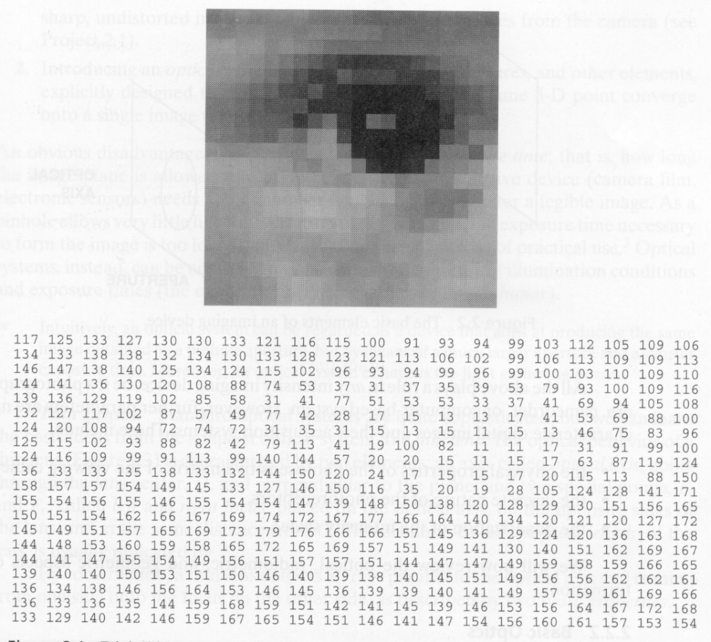
Digital Image: Representation
Gonzalez, Rafael C. Digital image processing. Pearson Education India. v
Notes:
In the case of $k$ bits/pixels, there are $2^{k}$ gray levels. For a $k−$bit system, the pixel values or intensity levels range from $0$ to $L−1$, where $L = 2^{k}$, $k$ is the number of bits required to represent the digital image.

Slide 15
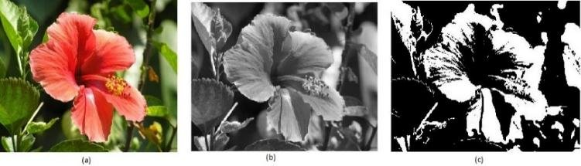
Digital Image: Types

Slide 16
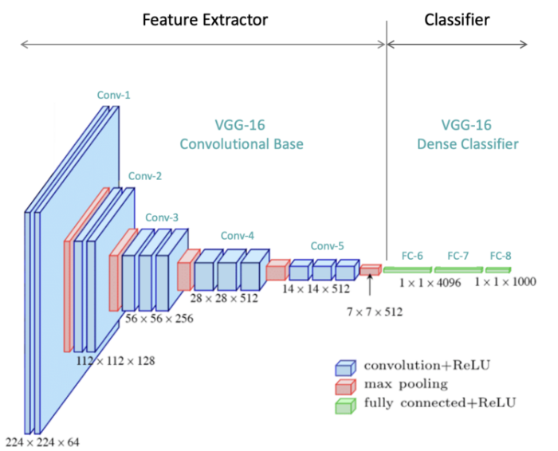
Convolutional Neural Networks
Convolutional Layer
Pooling Layer
Fully-connected Layer
https://learnopencv.com/understanding-convolutional-neural-networks-cnn/

Slide 17
Convolutional Layer
a sum of products is formed (convolution operation),
a bias value is added,
the result is passed through a non-linear activation function, and
the activation value becomes a single input to a following layer.
https://learnopencv.com/understanding-convolutional-neural-networks-cnn/

Slide 18
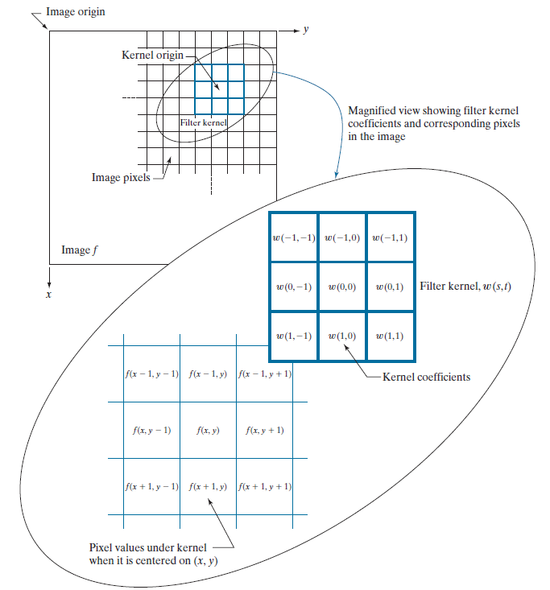

Convolution Operation
Spatial convolution
Sum of product operation
Gonzalez, Rafael C. Digital image processing. Pearson Education India.
Notes:
A spatial filter has a kernel consisting of filter coefficients. In the case of linear spatial filtering, spatial filters or kernels or masks or windows are slid through a region of an image and sum of product operation is performed. The size of the kernel defines it’s neighbourhood. The coefficients determine the nature of the filter. Both size and coefficients determine the kind of filtering operation. Linear spatial filtering is also called spatial convolution.

Slide 19
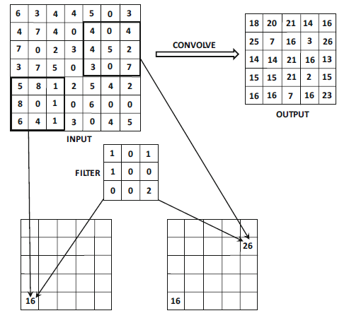
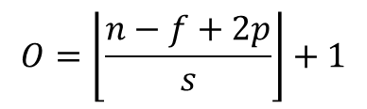
Convolution Operation
$$O=\left\lfloor \frac{n−f+2p}{s}\right\rfloor +1$$
Decreasing the stride length results in larger output feature dimension
“Neural Networks and Deep Learning”, Aggarwal, C. C. , 2018.

Slide 20
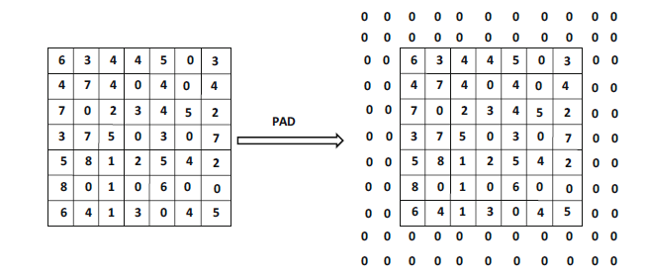
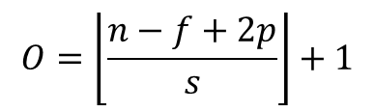
Convolution Operation: Padding
$$O=\left\lfloor \frac{n−f+2p}{s}\right\rfloor +1$$
If we increase padding, then the dimension of output would increase
https://learnopencv.com/understanding-convolutional-neural-networks-cnn/
“Neural Networks and Deep Learning”, Aggarwal, C. C. , 2018.

Slide 21
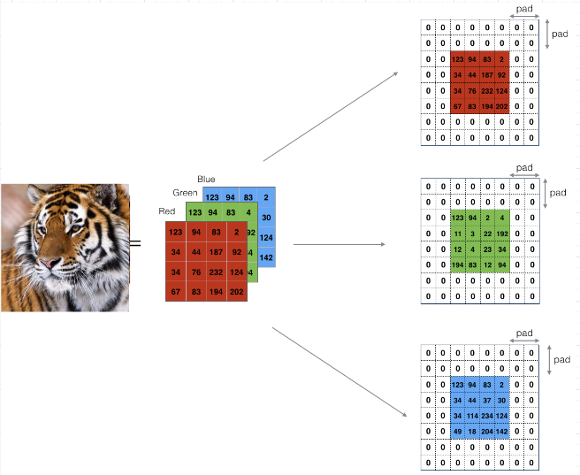
Convolution Operation: Padding
https://learnopencv.com/understanding-convolutional-neural-networks-cnn/
“Neural Networks and Deep Learning”, Aggarwal, C. C. , 2018.

Slide 22
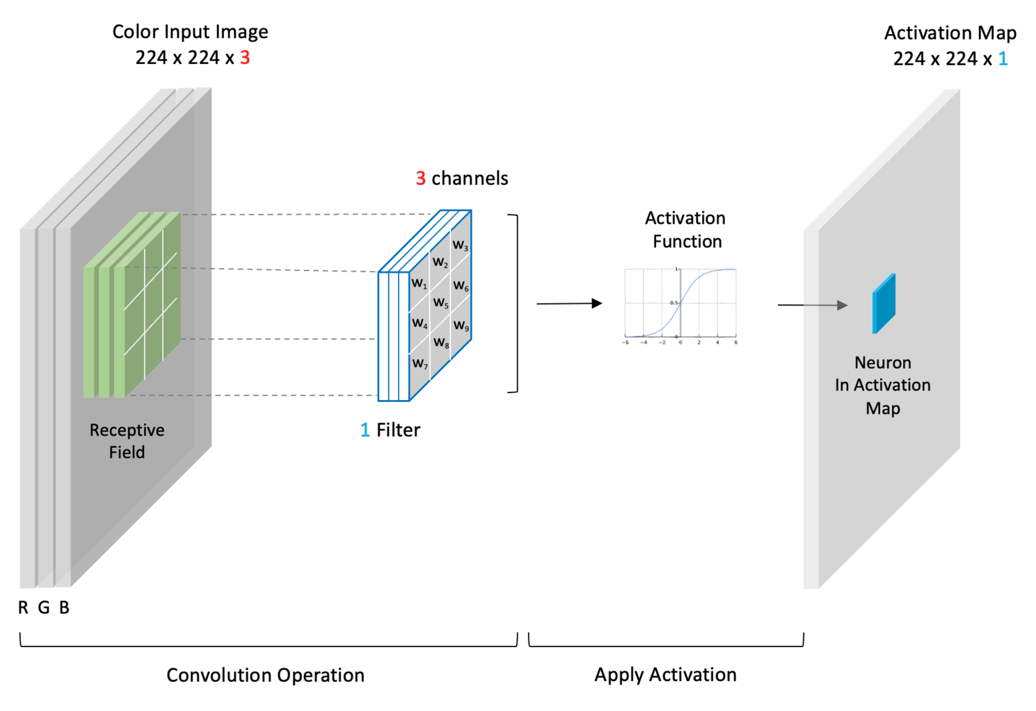
Convolutional Layer
weight (or parameter) sharing
https://learnopencv.com/understanding-convolutional-neural-networks-cnn/

Slide 23
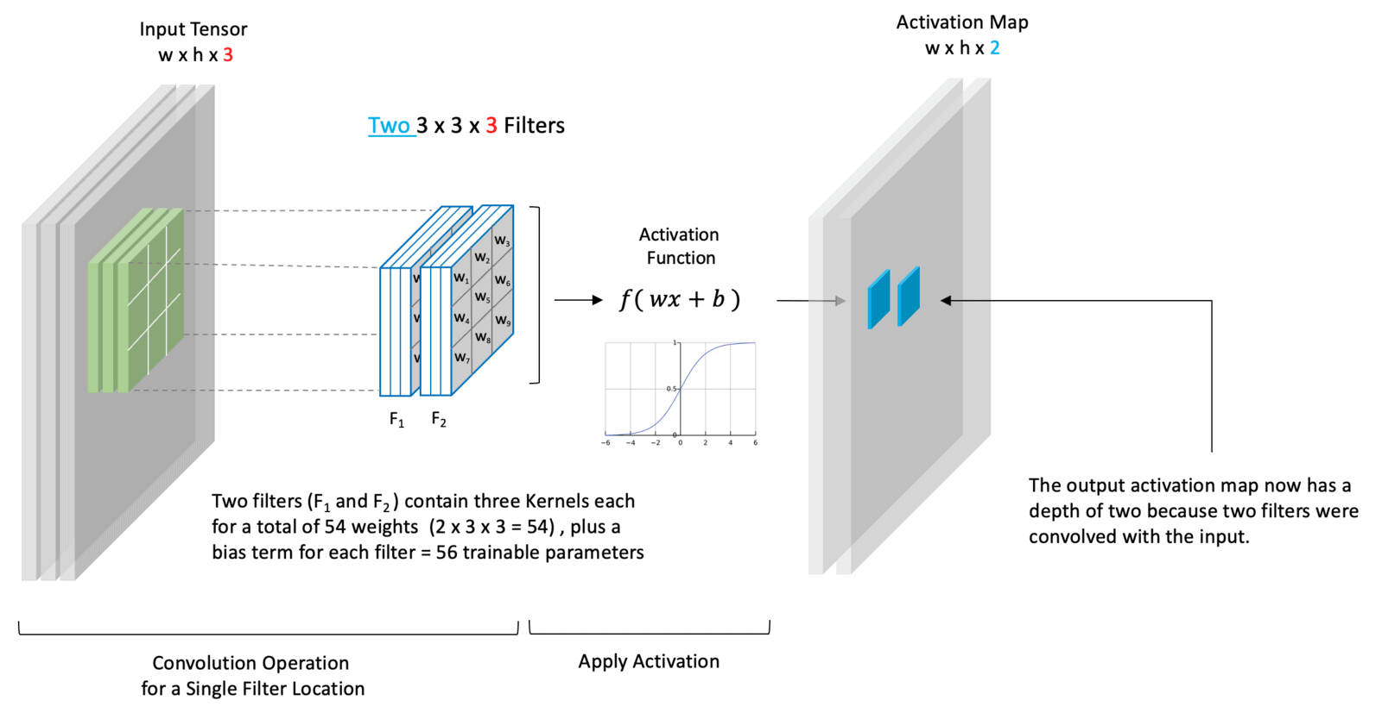
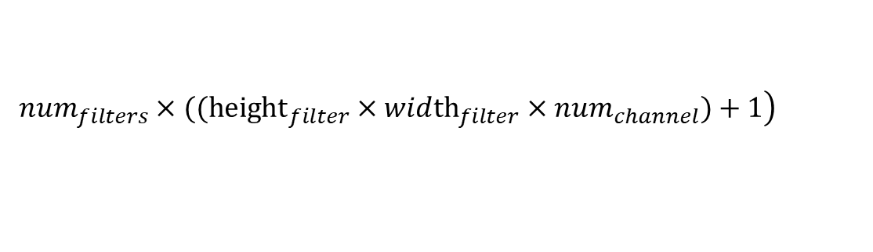
Convolutional Layer
$$\left.num_{filters}×(({height}_{filter}×wid{th}_{filter}×num_{channel})+1\right)$$
https://learnopencv.com/understanding-convolutional-neural-networks-cnn/c

Slide 24
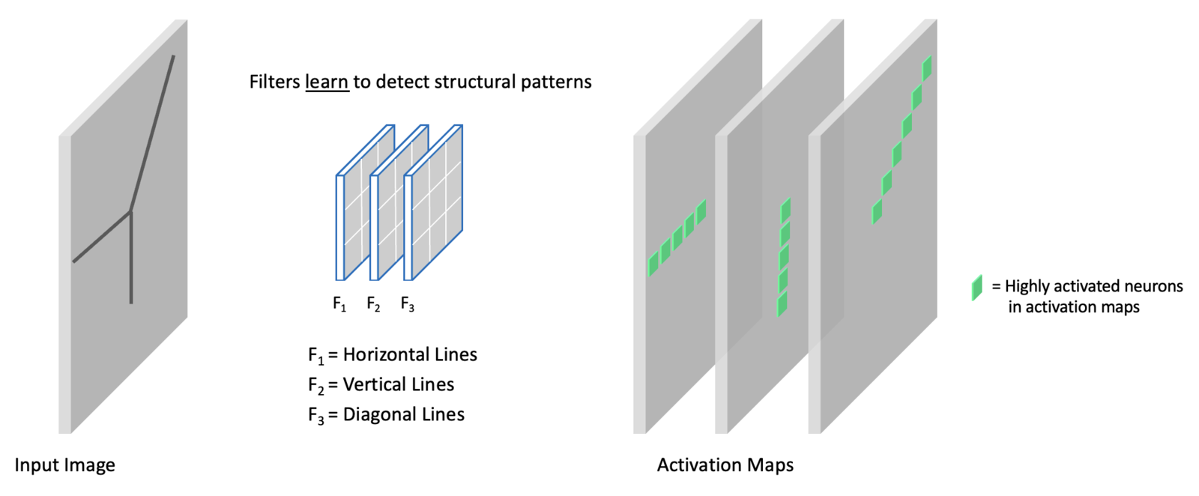
Convolutional Layer
Each set of weights and bias is different, so each feature map will contain a different set of features, all extracted from the same input image.
https://learnopencv.com/understanding-convolutional-neural-networks-cnn/c

Slide 25
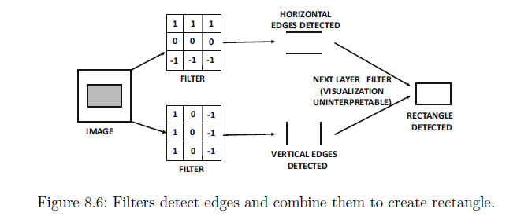
Convolutional Layer
“Neural Networks and Deep Learning”, Aggarwal, C. C. , 2018.

Slide 26
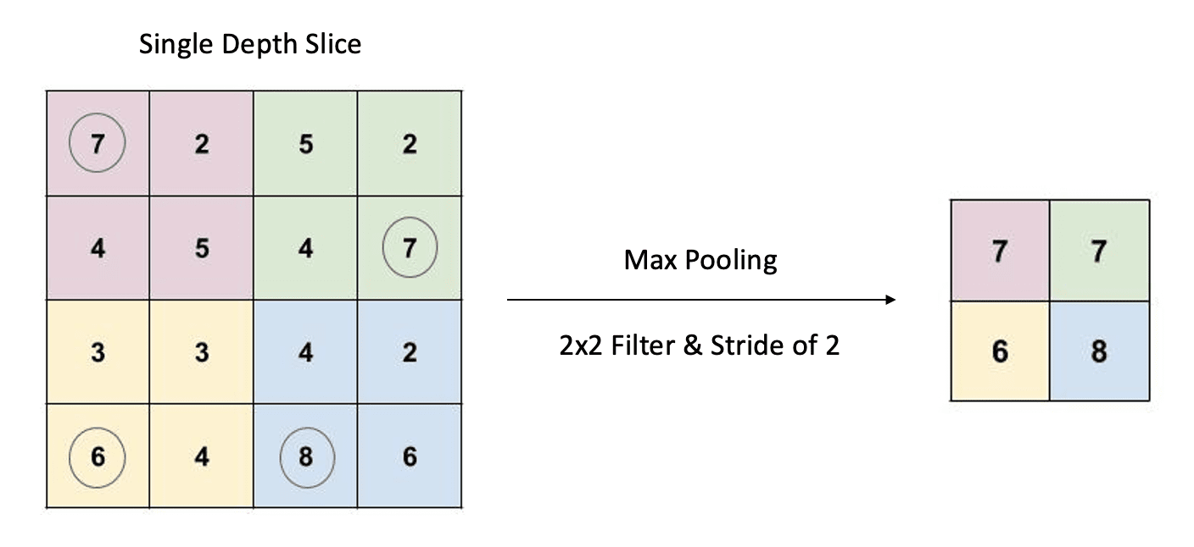
Pooling Layer
https://learnopencv.com/understanding-convolutional-neural-networks-cnn/c

Slide 27
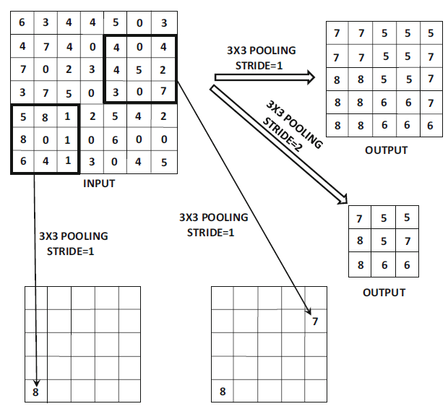
Pooling Layer
$$O=\left\lfloor \frac{n−f}{s}\right\rfloor +1$$
Increasing the stride results in reduced output dimension of the pooled feature maps
“Neural Networks and Deep Learning”, Aggarwal, C. C. , 2018.

Slide 28
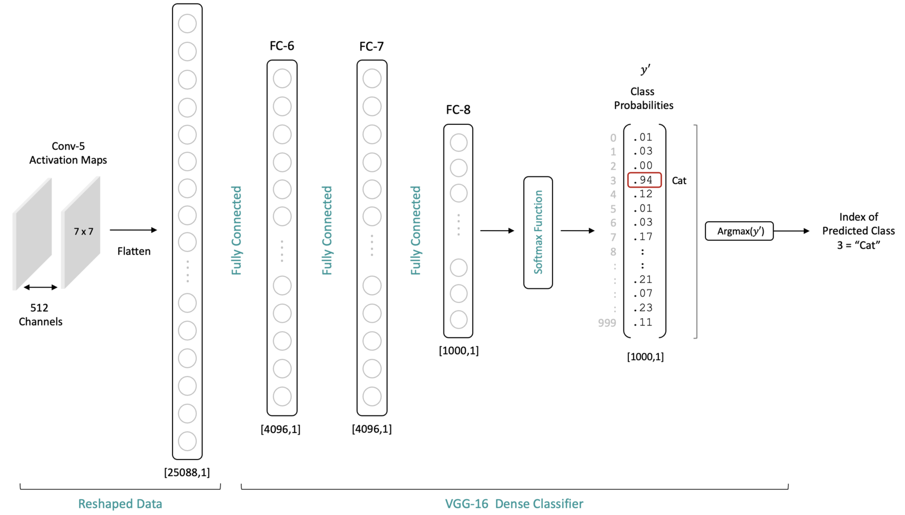
Fully-connected Layer
https://learnopencv.com/understanding-convolutional-neural-networks-cnn/

Slide 29
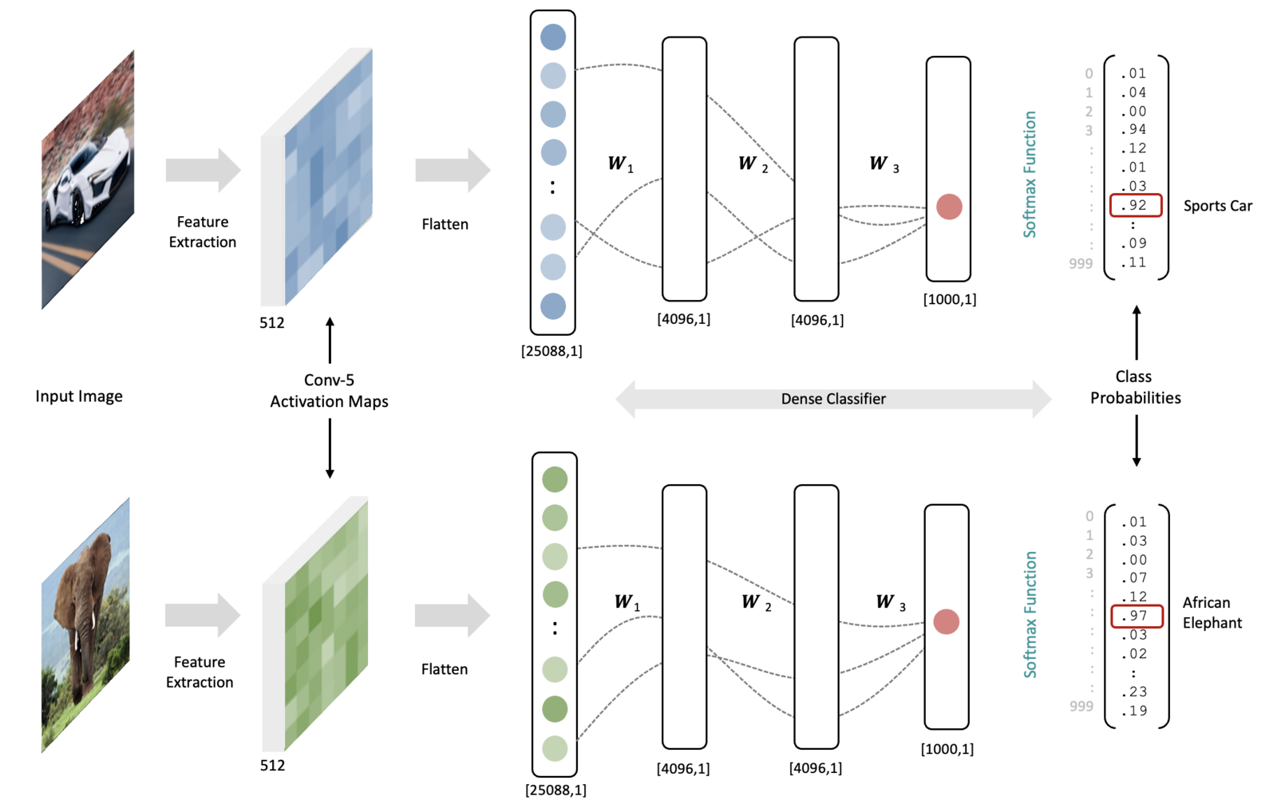
Convolutional Neural Networks
https://learnopencv.com/understanding-convolutional-neural-networks-cnn/c

Slide 30
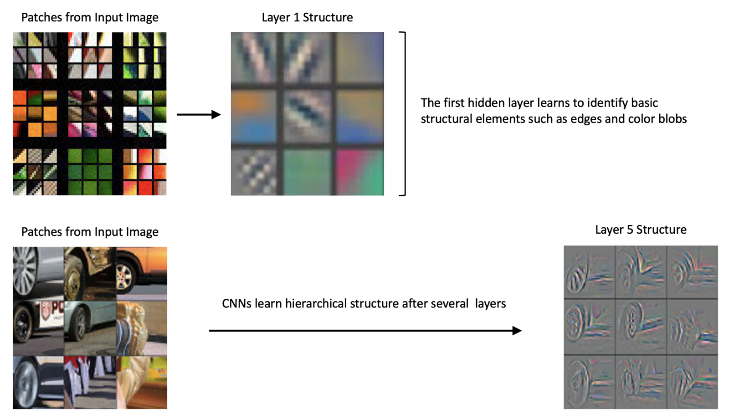
Convolutional Neural Networks
Zeiler, M. D., & Fergus, R. (2014). Visualizing and understanding convolutional networks. In Computer Vision–ECCV 2014: 13th European Conference, Zurich, Switzerland, September 6-12, 2014, Proceedings, Part I 13 (pp. 818-833). Springer International Publishing.

Slide 31
Convolutional Neural Networks
Dim_filter * n_channel * n_filters
Conv1-1: (3*3*3)*64 = 1,728
Conv1-2: (3*3*64)*64 = 36,864
Conv2-1: (3*3*64)*128 = 73,728
Conv2-2: (3*3*128)*128 = 147,456
Conv3-1: (3*3*128)*256 = 294,912
Conv3-2: (3*3*256)*256 = 589,824
Conv3-3: (3*3*256)*256 = 589,824
Conv4-1: (3*3*256)*512 = 1,179,648
Conv4-2: (3*3*512)*512 = 2,359,296
Conv4-3: (3*3*512)*512 = 2,359,296
Conv5-1: (3*3*512)*512 = 2,359,296
Conv5-2: (3*3*512)*512 = 2,359,296
Conv5-3: (3*3*512)*512 = 2,359,296
FC-6: 7*7*512*4096 = 102,760,448
FC-7: 4096*4096 = 16,777,216
FC-8: 4096*1000 = 4,096,000
Total: 138M parameters
https://learnopencv.com/understanding-convolutional-neural-networks-cnn/
https://cs231n.github.io/convolutional-networks/#conv

Slide 32
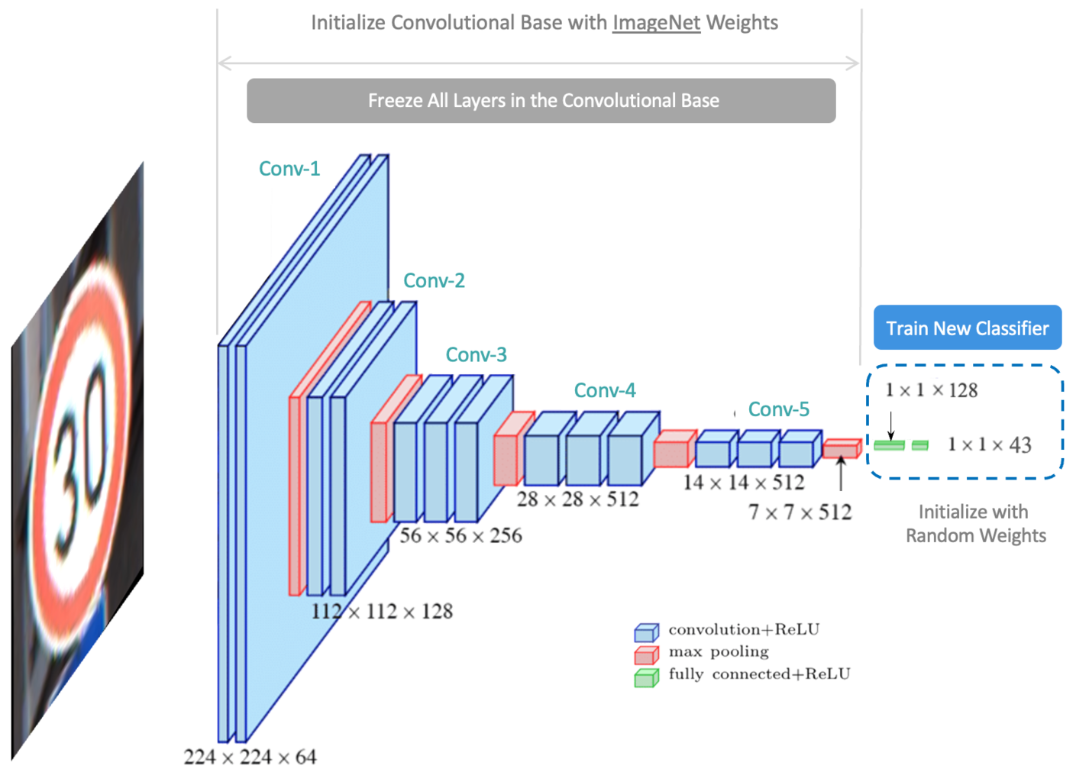
Pre-trained CNNs and Transfer Learning
Approach for re-purposing a pre-trained model to make predictions on a new dataset
https://learnopencv.com/understanding-convolutional-neural-networks-cnn/

Slide 33
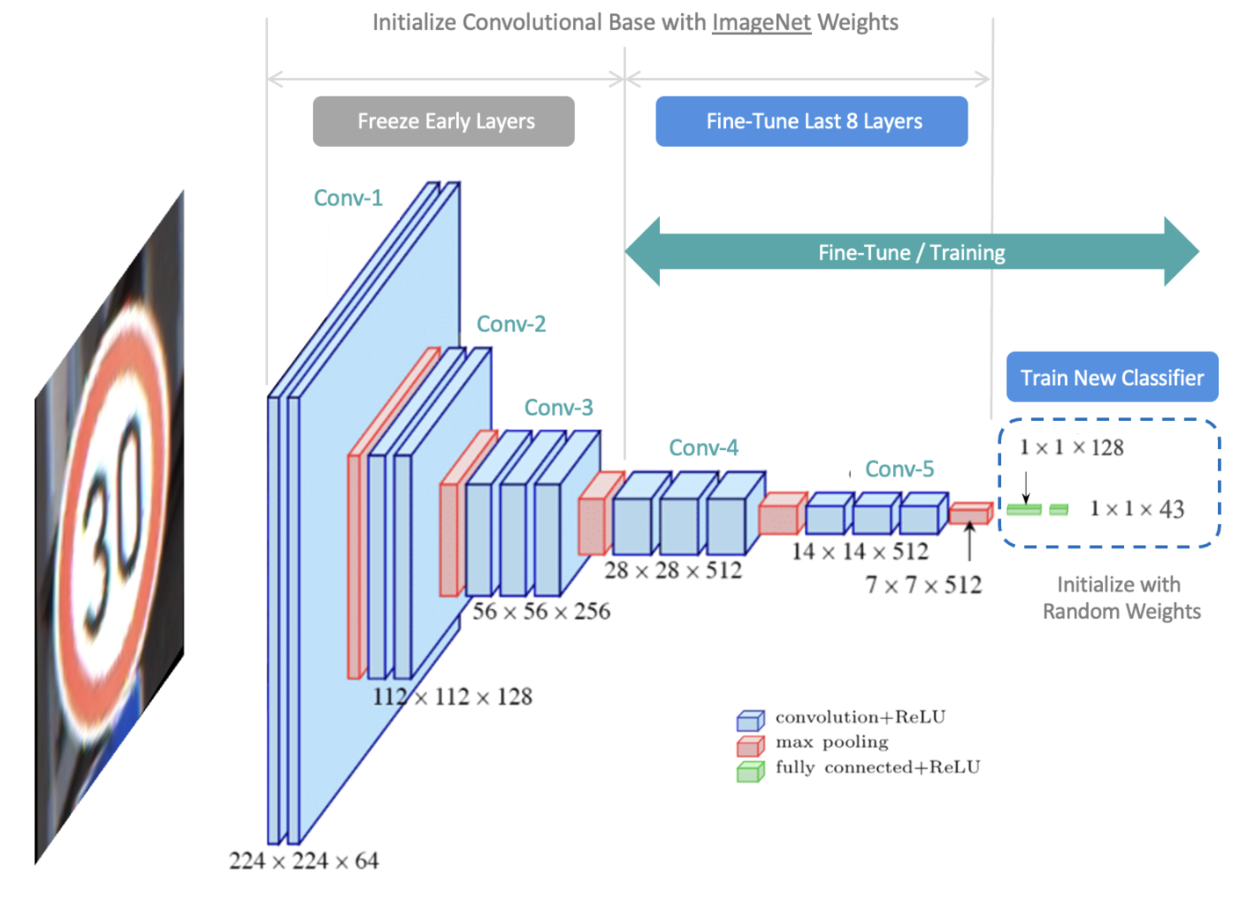
Pre-trained CNNs and Fine-tuning
https://learnopencv.com/understanding-convolutional-neural-networks-cnn/

Slide 34
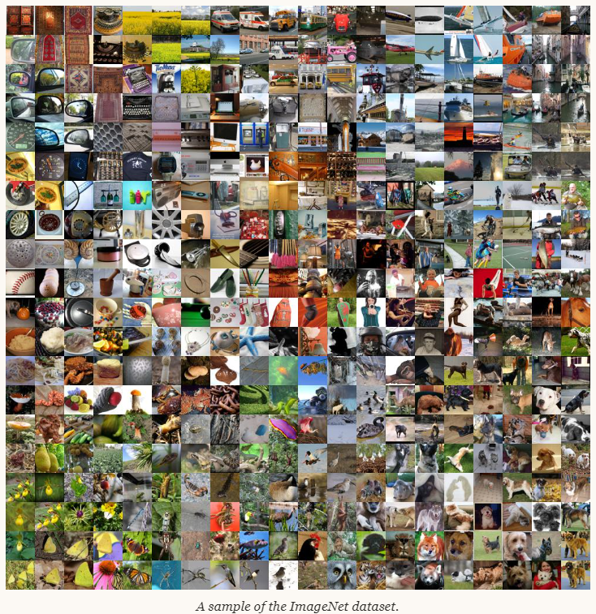
ImageNet Dataset
ImageNet Large Scale Visual Recognition
Challenge (ILSVRC): 2010
1000 Classes
1,431,167 or 1.4 million images
J. Deng, W. Dong, R. Socher, L.-J. Li, K. Li and L. Fei-Fei, ImageNet: A Large-Scale Hierarchical Image Database. IEEE Computer Vision and Pattern Recognition (CVPR), 2009.
Russakovsky, Olga, et al. "Imagenet large scale visual recognition challenge." International journal of computer vision 115 (2015): 211-252.

Slide 35
Back Propagation in a CNN
Forward Pass
Loss Computation
Gradient Computation
Backward Pass

Slide 36



Forward Pass
Convolutional Layer
Pooling Layer
$$maxpool(I∗K)\left(i,j\right)=\max_{1≤s,t≤m,n}{(I∗K)\left(s,t\right)}$$
Fully Connected Layer
https://www.quarkml.com/2023/07/backward-pass-in-convolutional-neural-network-explained.html
Notes:
In the forward pass, the input passes through the layers of the network and output is computed. The Forward Pass starts from the Convolutional Layer where Convolution operation is performed between the input image and the kernels. The result is passed through a non linear activation function to get the output feature map. The first equation describes the convolution operation between input I and kernel K. The i,j are indices that are used to represent a single pixel in the input image, kernel, and the produced output. m,n are used to represent the dimensions (height, width) of the filter or kernel. As i and j change, the filter is applied through each of the input pixels. The bias term bi is added to this result. In convolution the kernel is rotated 180 degrees before the element wise multiplication.
We have already discussed, pooling layer downsamples its input by performing either max pooling or average pooling operation. In the case of Max Pooling, a window slides over the input feature map, and the maximum value within each window is selected as the output. The second equation represents this operation, m and n are the size of the pooling window.
The output of the last pooling layer is then flattened and given as input to the fully connected layer. Similar to the MLP, each neuron is connected to every neuron in the previous layer. Unlike convolutional and pooling layers that share weights across inputs, the Fully Connected Layer assigns unique weights for each dense connection. The third equation represent the forward pass for the fully connected layer, where W are the weights, b is the bias, and Φ is the activation function.

Slide 37
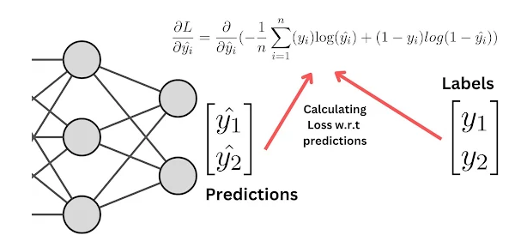
Loss Computation
Binary cross-entropy loss function: finds the dissimilarity between the predicted probability and the true binary label
Notes:
Backpropagation is nothing but doing the reverse of the forward pass where we find the gradient of each of the neuron with respect to the loss function to determine how much the output contribute to the overall loss. In Forward Pass, we start from the Convolution Layer until the Fully Connected Layer, In backpropagation, we start from the Fully Connected Layer all the way up to the Convolution Layer.
The first step is to find a Loss Function which is used to evaluate the predicted output. Lets consider binary cross entropy loss function, which finds the dissimilarity between the predicted probability score and the true binary label. In this case, y1 and y2 are the true labels and y1^ and y2^ are the predicted probabilities.

Slide 38



Gradient Computation
Chain Rule
Notes:
We can find the the derivative of Loss with respect to ^yi by applying the chain rule.

Slide 39


Backpropagation through FC Layer
Weights and bias are updated as
Notes:
Lets first discuss the backpropagation through the fully connected layer. This is same as the backpropagation of the MLP. Our objective is to update the weights and biases of the dense connections using this formula, n is the learning rate which decides the step size. This formula is based on the Stochastic Gradient Descent Algorithm, where we will have to update the parameters in the negative direction of the gradient.

Slide 40


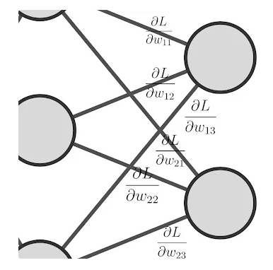



Backward Pass
Derivative of loss with respect to weights
Notes:
We need to find the gradient of loss with respect to weights, which represents how much the changes in weights affect the loss function. We can do so by applying the chain rule again.

Slide 41

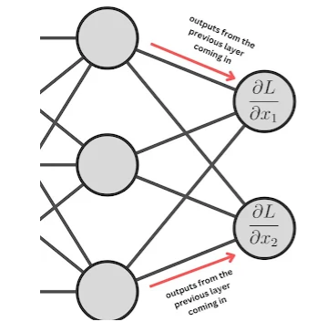

Backward Pass
Derivative of loss with respect to inputs
Notes:
Next, let's find the gradient of the loss with respect to inputs, ie, how much the change in inputs affects the loss. Note that the inputs to one corresponding layer are the output coming from the previous layer, and hence we will express the gradient of the loss function with respect to the inputs as this. The change in loss with respect to input is influenced by the weights and the change in loss with respect to the outputs.

Slide 42




Backward Pass
Derivative of loss with respect to bias
Notes:
Finally, we need to find the gradient of loss with respect to bias, ∂L∂bj using the chain rule. This represents how much the loss changes with respect to the outputs, and how much the output changes with respect to the bias.
The next and most important step in backpropagation is to update the weights and bias using the gradients of weights and bias, using the expression that we had discussed already.

Slide 43
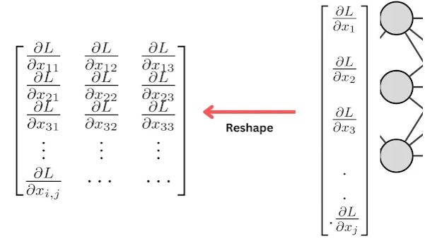


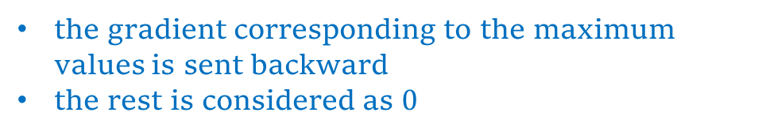
Backpropagation through Pooling Layer
the gradient corresponding to the maximum values is sent backward
the rest is considered as $0$
There is no actual gradient calculation done
Instead, passing the gradient backward according to the Pooling function used
Notes:
When going backward, the next layer after the Dense Layer is a Pooling Layer. So the next step is to pass the gradients of inputs produced from the Dense layer to the Pooling Layer. But we had flattened the output of pooling layer before giving it as input to the dense layer. So, in the backward pass, we need to convert the 1D gradient vector into 2D gradient matrix through reshape operation. The process of reshaping in the backward pass can be determined based on the shape of the pooling layers in the forward pass. The specific shape of the pooling layers will determine how the 1D gradient vector from the Dense layer should be transformed back into a 2D gradient matrix.
When considering Pooling in general, there is no actual gradient calculation done, instead, passing the gradient backward according to the Pooling function used. In the case of Max Pooling, we will select the maximum value from each window and produce the output in the forward pass, In backpropagation, the gradient corresponding to the maximum values is sent backward and the rest is considered as 0. If the value became 1, then the gradient is passed backward and if the value became 0, then the gradient is not passed.

Slide 44




Backpropagation through Conv Layer
Notes:
The backward derivations for the Dense Layer and Convolutional Layer share certain similarities. The only difference is that here we apply Convolution rather than dot product operation. Similar to the Dense Layer, we need to find the gradients with respect to weights, inputs, and bias.
To find the derivative of Loss with respect to weights in a Convolution Layer, we have to convolve the output gradient feature map and the input matrix. The equation for finding how much the loss changes with respect to the weights using the chain rule is expressed. We observe that the kernel gradients are produced by convolving the gradients in the output matrix and the values in the input matrix. Similarly, the change in loss with respect to inputs and bias can be given by computing the gradient of the Loss with respect to inputs and bias respectively. As its convolution operation, the kernel has to be rotated 180 degrees.

Slide 45


Backpropagation through Conv Layer
Kernel Coefficients and bias are updated as
Notes:
Next, we update the weights and biases using the backpropagation formula.

Slide 46
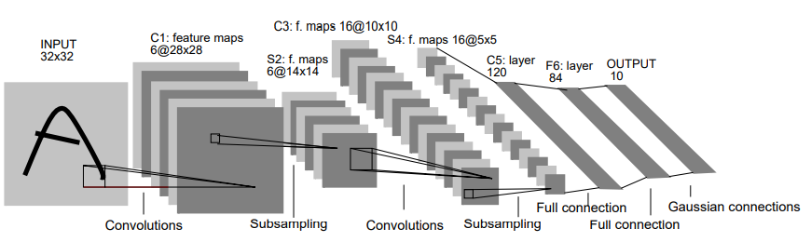
LeNet5 (1990 - 1998)
LeCun, Yann, et al. "Gradient-based learning applied to document recognition." Proceedings of the IEEE 86.11 (1998): 2278-2324.
Notes:
LeNet-5 Ws developed by Yann LeCun in 1990’s. It was popularly used for digit classification (MNIST dataset).

Slide 47
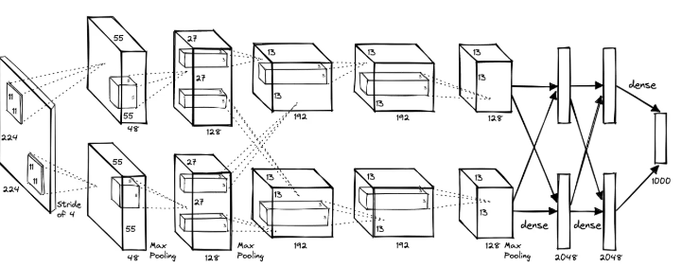
AlexNet
Krizhevsky, Alex, Ilya Sutskever, and Geoffrey E. Hinton. "Imagenet classification with deep convolutional neural networks." Advances in neural information processing systems 25 (2012).
Notes:
The AlexNet was submitted to the ImageNet ILSVRC challenge in 2012 and significantly outperformed the second runner-up (top 5 error of 16% compared to runner-up with 26% error). The Network had a very similar architecture to LeNet, but was deeper, bigger, and featured Convolutional Layers stacked on top of each other (previously it was common to only have a single CONV layer always immediately followed by a POOL layer). AlexNet used the ReLU activation function, which helped in faster training by mitigating the vanishing gradient problem that was common with traditional activation functions like sigmoid and tanh. It leveraged GPU acceleration for training, which significantly reduced the training time. To prevent overfitting, AlexNet employed dropout regularization in its fully connected layers. Additionally, it used data augmentation techniques such as image translations, horizontal reflections, and patch extractions to artificially increase the size of the training dataset. This helped in improving the model's generalization ability.

Slide 48
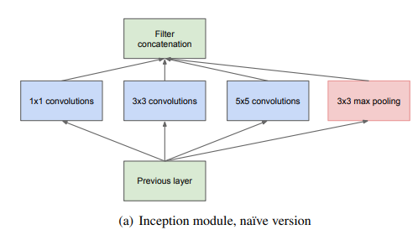
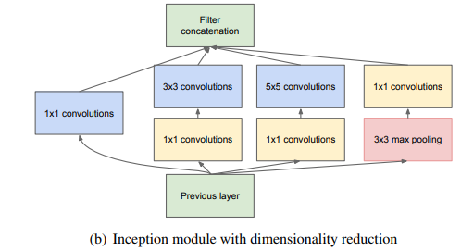
GoogLeNet
Szegedy, Christian, et al. "Going deeper with convolutions." Proceedings of the IEEE conference on computer vision and pattern recognition. 2015.
Notes:
The ILSVRC 2014 winner was a Convolutional Network from Szegedy et al. from Google. Its main contribution was the development of an Inception Module that dramatically reduced the number of parameters in the network (4M, compared to AlexNet with 60M). The Inception architecture, which uses multiple filter sizes (1x1, 3x3, and 5x5) within the same layer to capture different levels of detail.

Slide 49
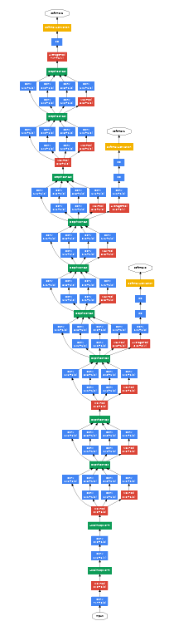
GoogLeNet
Szegedy, Christian, et al. "Going deeper with convolutions." Proceedings of the IEEE conference on computer vision and pattern recognition. 2015.
Notes:
These modules allow the network to choose between different convolutional filter sizes in each block, enhancing its ability to capture diverse features. GoogLeNet is 22 layers deep, significantly deeper than previous models like AlexNet, yet it is computationally efficient due to the use of 1x1 convolutions for dimensionality reduction. This is also because, this network uses Average Pooling instead of Fully Connected layers at the top of the ConvNet. To combat the vanishing gradient problem, GoogLeNet includes auxiliary classifiers at intermediate layers, which help in training the deep network more effectively. GoogLeNet achieved a top-5 error rate of 6.7% in the 2014 ImageNet Large Scale Visual Recognition Challenge (ILSVRC).

Slide 50
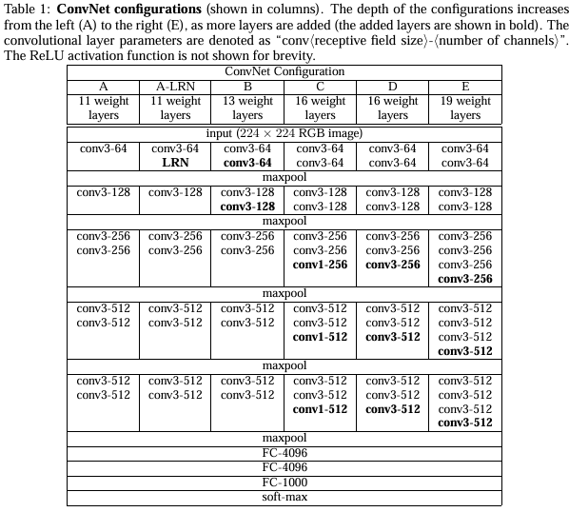
VGGNet
Simonyan, Karen. "Very deep convolutional networks for large-scale image recognition." arXiv preprint arXiv:1409.1556 (2014).
Notes:
The runner-up in ILSVRC 2014 was the network from Karen Simonyan and Andrew Zisserman, developed by the Visual Geometry Group at the University of Oxford. VGGNet is known for its simplicity and uniform architecture, using only 3x3 convolutional layers stacked on top of each other, with increasing depth. The most common versions are VGG-16 and VGG-19, which have 16 and 19 weight layers, respectively. VGGNet achieved a top-5 error rate of 7.3% on the ImageNet dataset. The depth of VGGNet allows it to capture more complex features, but it also results in a large number of parameters (138 million for VGG-16), making it computationally expensive.

Slide 51
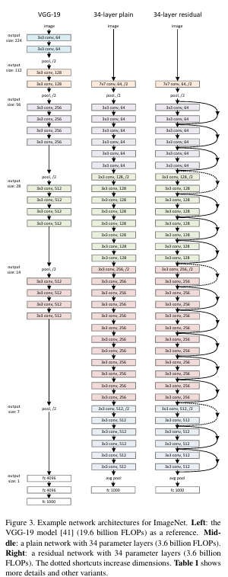
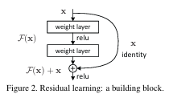
ResNet
Notes:
Residual Network developed by Kaiming He et al. was the winner of ILSVRC 2015. The core idea of ResNet is the use of residual blocks, which allow the network to learn residual functions with reference to the layer inputs. This helps in addressing the vanishing gradient problem during backpropagation, making it possible to train very deep networks. During forward pass the residual block lets the convolutional layers learn identity functions, thereby reducing complexity of the model.

Slide 52
References
“Deep Learning”, An MIT Press book, Ian Goodfellow and Yoshua Bengio and Aaron Courville, http://www.deeplearningbook.org
https://onlinecourses.nptel.ac.in/noc22_cs124/preview
“Neural Networks and Deep Learning”, Aggarwal, C. C. , 2018.
"Gradient-Based Learning Applied to Document Recognition" by Yann LeCun, Léon Bottou, Yoshua Bengio, and Patrick Haffner.
Zeiler, M. D., & Fergus, R. (2014). Visualizing and understanding convolutional networks. In Computer Vision–ECCV 2014: 13th European Conference, Zurich, Switzerland, September 6-12, 2014, Proceedings, Part I 13 (pp. 818-833). Springer International Publishing.

Slide 53
Thank You

